Slide 1
PROJECT TITLE
PIP104 PROFESSIONAL PRACTICE-II
VIVA-VOCE
Batch Number:
Roll Number | Student Name
20201CSE0538 | NIKSHITH K S
20201CSE0558 | NAVEEN R
20201CSE0541 | KISHAN GOWDA
Under the Supervision of,
Dr. Joseph Michael Jerard V
Professor
School of Computer Science Engineering
Presidency University

Slide 2
Introduction
Many countries are working on transforming themselves into Smart Countries. If the city is going to be called a Smart City, then it should have all possible achievements in the sector of smart technology which is needed. This is the most challenging job to improve efficiency in the healthcare sector. It includes various aspects such as getting an ambulance in a minimum amount of time and providing proper treatment to the patient so that the chance of surviving increases in critical condition. Due to traffic, many problems are raised in urban areas which have caused much difficulty for the ambulance. Nowadays, road accidents in the city have increased and the loss of life due to accidents is even more crucial. We can overcome these limitations by upcoming technology like the Internet of Things and also ambulance services. Various hardware devices can be connected via wired and wireless networking tools and software implementations by which service will be provided faster to the users. By keeping these things in mind we’ve developed this application. It is also an attempt to participate actively in the process of transforming into a smart city and making required services more accessible will help users.
The introduction of the Medical Ambulance idea, which is comparable to the well-known ride-hailing services Ola and Uber, is a ground-breaking development in the field of patient transportation and emergency healthcare. By customizing on-demand ride services to the specific requirements of the healthcare sector, this creative method capitalizes on the effectiveness and convenience of these services. The following salient features underscore the importance of a Medical Ambulance service that draws inspiration from Ola and Uber

Slide 3
Literature Review
“Mobile Ambulance Management Application for Critical Needs” by P Devagayathri, R Amritha Varshini, MI Pooja and S Subbulakshmi which was published in 2020 Fourth International Conference on Computing Methodologies and Communication (ICCMC)
“Design and Implementation of Free Ambulance Service System in Bandar Lampung City Based on Android Mobile Application” by Gigih Forda Nama, Candra Kurnia Nugraha and Hery Dian Septama which was published in 2022 Seventh International Conference on Informatics and Computing ( ICIC)
“A Survey on existing system design used for managing ambulance booking through mobile App” by L.Srinivasan, Br Monika, Shaik Anju Minayar, Sanjeevani Sharma and Navya Sood which was published in 2023 International Conference on Computer Communication and Informatics (ICCCI) .
“Improving the Performance of Ambulance Emergency Service Using Smart Health Systems” by Mohammed Abdin, Mohammed Hassim Ahmed, Hafez Selium, Mustafa El-Nainay and Tarek Rahil Sheltami which was published by 2021 IEEE/ACM Conference on Connected Health:Applications, Systems and Engineering Technologies(CHASE)

Slide 4
UBER FOR AMBULANCES, EMERGENCY HEALTH RESPONSE AND BLOOD INVENTORY - Chetan Pawar, Ronil Patil , Shubham Adivarekar, Hiteshree Navale, Prof. Rohini Patil
Ambuitec : Ambulance Booking Application for Emergency Health Response, Blood Inventory - Prof. Shyamsundar Magar, Mr. Vinayak Jadhav, Mr. Omkar Raut
AMBULANCE SERVICE - Mrs. Chavan Pragati P. , Ms.Thosar Mrunal R. , Ms. Panchal Sudha M. ,Ms.Bandel Pooja D
eEmergency System to Support Emergency call Evaluation and Ambulance dispatch Procedures - Efthyvoulos Kyriacou , Riana Constantinou, Chris Kronis , George Hadjichristofi , Constantinos Pattichis

Slide 5
Research Gaps Identified
Cost-Effectiveness and Affordability
Resource Intensity in Image Processing
Network Dependency for Mobile Applications
Compatibility and Integration Challenges
User-Friendly Interfaces and Adoption
Scalability and Adaptability
Limited Comprehensive Security Features
Energy Efficiency

Slide 6
Proposed Methodology
Planning and Requirements Gathering
Design and Development
Testing and Deployment
Maintenance and Improvement
Timeline for Execution of Project
Expected Outcomes
-> Improved Accessibility and Response Time
-> Enhanced Patient Experience
-> Optimal Resource Utilization
-> Technological Integration

Slide 7
Objectives
Reduced Response Times: The app should help to reduce response times by streamlining the ambulance dispatch process.
Real-time location tracking: The app should be able to track the location of ambulances in real-time, allowing dispatchers to send the nearest available ambulance to the scene of an emergency.
Automated dispatch: The app can automatically dispatch the closest
ambulance based on the user's location and the type of medical emergency.
Traffic updates: The app can use real-time traffic data to route ambulances around congestion and delays.
Service fees: Users can see transparent pricing information for different ambulance services.
Simplified booking: Easy-to-use interface allows for quick and stress-free ambulance requests, even in emergency situations.
Overall, the objectives of an ambulance service app are to:
Save lives: By reducing response times and improving communication, ambulance service apps can help to save lives in emergency situations.
Improve efficiency: By streamlining the process of requesting and dispatching ambulances, ambulance service apps can help to save time and money.
Enhance user experience: By providing users with easy access to information and services, ambulance service apps can help to improve the user experience

Slide 8
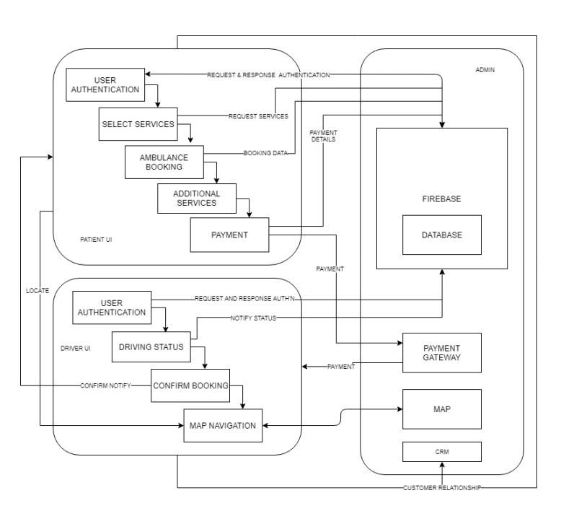
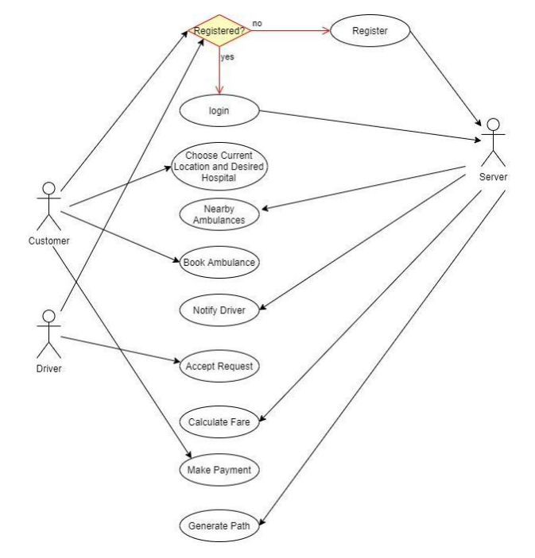
System Design & Implementation
System Architecture Usecase Diagram

Slide 9
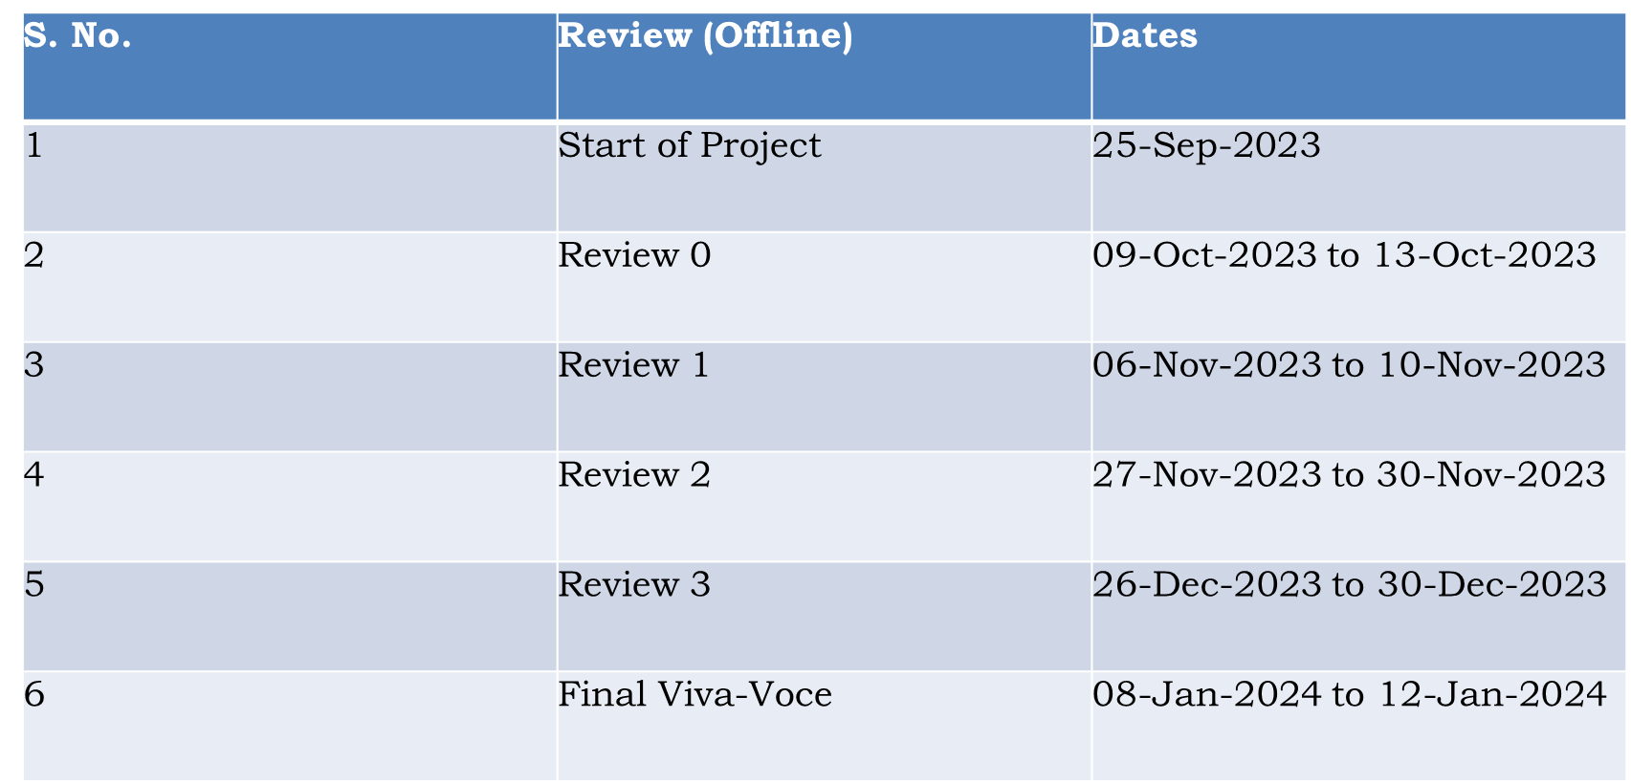
Timeline of Project

Slide 10
Outcomes / Results Obtained
1.Enhanced Patient Access: Medicab services have significantly increased accessibility to healthcare facilities, particularly benefiting individuals with limited mobility, disabilities, or those residing in remote areas. The availability of reliable transportation has facilitated timely access to medical appointments and treatments.
2.Reduced Missed Appointments: The implementation of efficient scheduling systems and real-time tracking has led to a reduction in missed or delayed medical appointments. Patients can rely on Medicab services for prompt and timely transportation, improving adherence to healthcare schedules.
3.Improved Patient Satisfaction: The user-friendly nature of Medicab applications and the convenience they offer in scheduling rides have positively impacted patient satisfaction. The transparent tracking system allows patients to monitor their transportation in real-time, contributing to an overall positive experience.
4.Streamlined Operations for Healthcare Providers: Medicab services have streamlined transportation logistics for healthcare providers. Optimized routes and efficient coordination have led to improved operational efficiency, allowing healthcare facilities to focus more on delivering quality care.
5.Cost-Effective Solutions: Through route optimization and resource management, Medicab services have demonstrated cost-effectiveness for both patients and healthcare providers. This ensures that transportation services are efficient and economically viable.
6.Positive Impact on Health Outcomes: By addressing transportation barriers, Medicab services have played a role in positively influencing health outcomes. Patients can access healthcare facilities in a timely manner, contributing to better management of chronic conditions and overall health improvement.

Slide 11
Conclusion
Currently, there is not much development in the field of mobile application-based health services, with only a few projects working to aid ambulances. It is our attempt to change the scenario through this project by providing a more user-friendly experience. This will be beneficial for the users in case of any type of emergencies as it saves time which gets consumed in searching for the ambulance by other means. The project also hopes to assist the ambulance drivers by providing the most efficient path right from picking up the patient to reaching the hospital.
When both the user and the driver are benefitted in this way, it will lead to the bridging of the communication gap between them, thus ensuring that timely emergency medical service is provided to the patient and their likelihood of treatment and survival is maximized.
Our conclusion is we have developed our project and if it works as we have expected then it will be very successful application which will be useful in our day-to-day life. And according with smart city project we will be able to go one step forward in health sector also.

Slide 12
References
Rajesh, Rupali & Chincholkar, Snehal. (2018). A Study on Consumer Perception of Ola and Uber Taxi Services. 3. 25-31. 10.17010/ijcs/2018/v3/i5/138779.
Mrs. Chavan PragatiP., Ms.Thosar Mrunal R.,Ms. Panchal Sudha, Ms. Bandel Pooja D, “Ambulance Service”, International Journal of Advanced Research in Computer and Communication Engineering, Vol-5, Issue-2,2019, pages 2395-4396
Sareen Fathima, Suzaifa, Abdo H Guroob, Mustafa Basthikodi, “An Efficient Application Model of Smart Ambulance Support (108) Services”, International Journal of Innovative Technology and Exploring Engineering (IJITEE) ISSN: 2278-3075, Volume-8, Issue- 6S4, April 2019
Shekar, Smitha, Narendra Kumar, Usha Rani, Divyashree, Gayatri George and Aparajitha Murali. “GPS Based Shortest Path for Ambulances using VANETs.”
Monika Sharma and Sudha Morwal, “Location Tracking using Google Geolocation API”
https://click2clinic.com/blog/45/Challenges-in-Ambulance-Travel
https://medium.com/@narengowda/uber-system-design-8b2bc95e2cfe
https://bootcamp.uxdesign.cc/case-study-designing-uber-for-ambulance-6fecef139efe

Slide 13
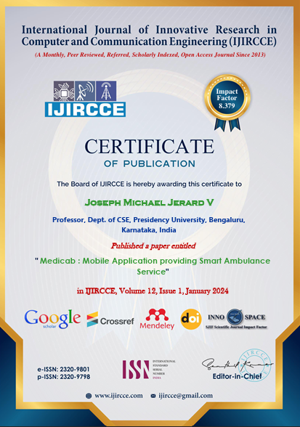
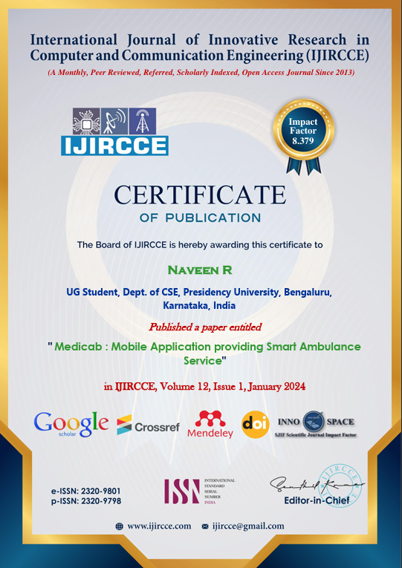
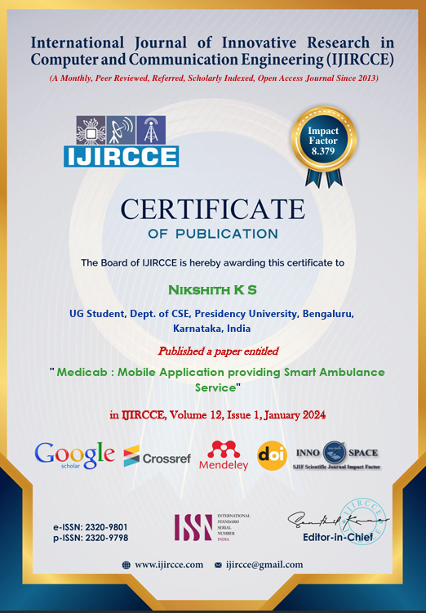
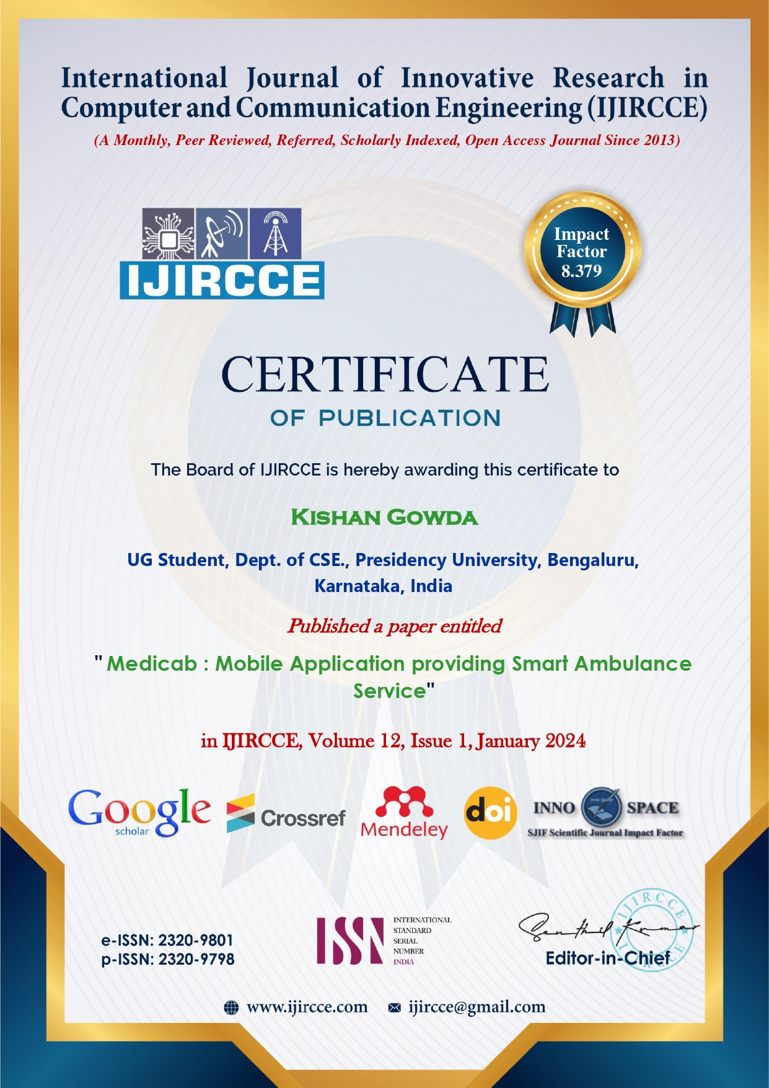
Publication Details

Slide 14

Thank You

